Slide 1


Building the economic foundations for democracy
in Haiti

Slide 2
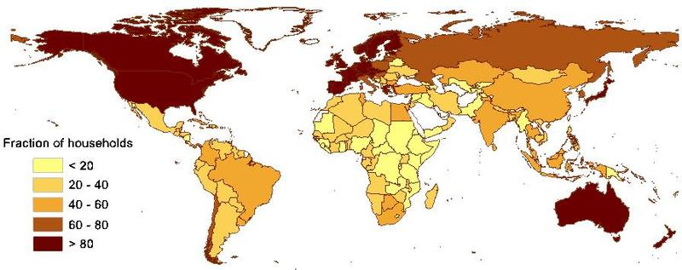
Financial services are essential
But 3.6 billion people worldwide do not have access to financial services
Notes:
Financial services are essential for building businesses, protecting assets and investing in the future. But across the world almost 50% of people have no access to financial services, especially in the poorest countries. Haiti is one of these extremely poor countries.
2

Slide 3
Microfinance is Not Only Credit
Micro-savings
Micro-insurance
Micro-capital
Money transfers (remittances)
Currency exchange
Non Financial services
Financial literacy
Leadership training
Business support
Health
and more
Notes:
Without question,microfinance,including microinsurance, Are powerful tools that allow families to lift themselves out of poverty . . . On their own terms,
in a sustainable way. But is microfinance successfully reaching the very poorest? is microfinance successfully reaching the very poorest?
Extremely poor people often choose not to borrow
Group members don’t guarantee repayment
The poorest need other services (health, education, nutrition) that MFIs choose not to provide for sustainability reasons
They are the most socially excluded and are ignored and isolated even in their own communities and are therefore hard for MFIs to find
These choices by the poorest, by borrower groups and by MFIs are sound choices that no one recommends be changed.

Slide 4
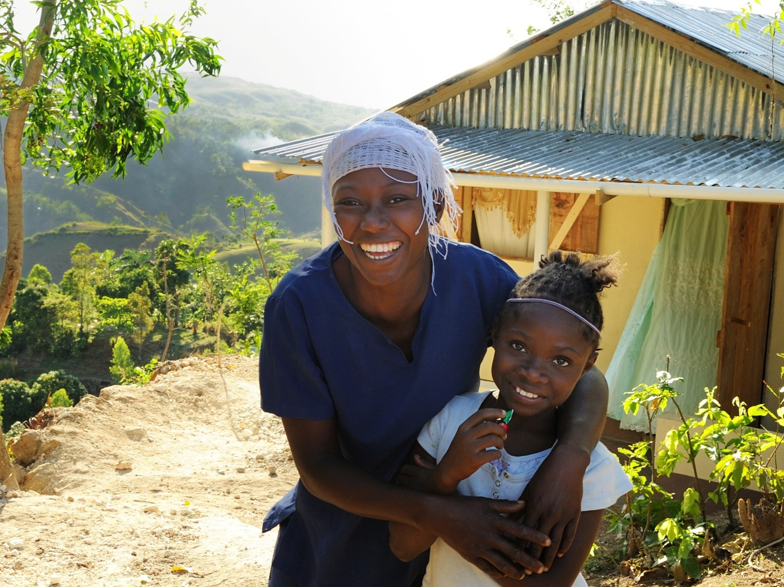

Slide 5
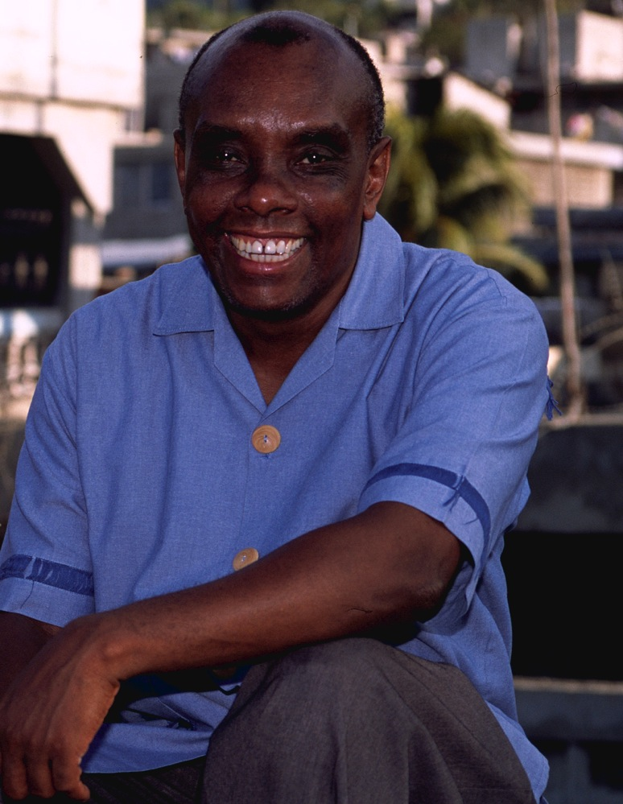
“Every human being deserves to live in dignity, with schools and churches to attend, food and clean water for themselves and their children, access to health care shelter, and safe communities.”
-- Father Joseph Philippe, CSSp

Slide 6
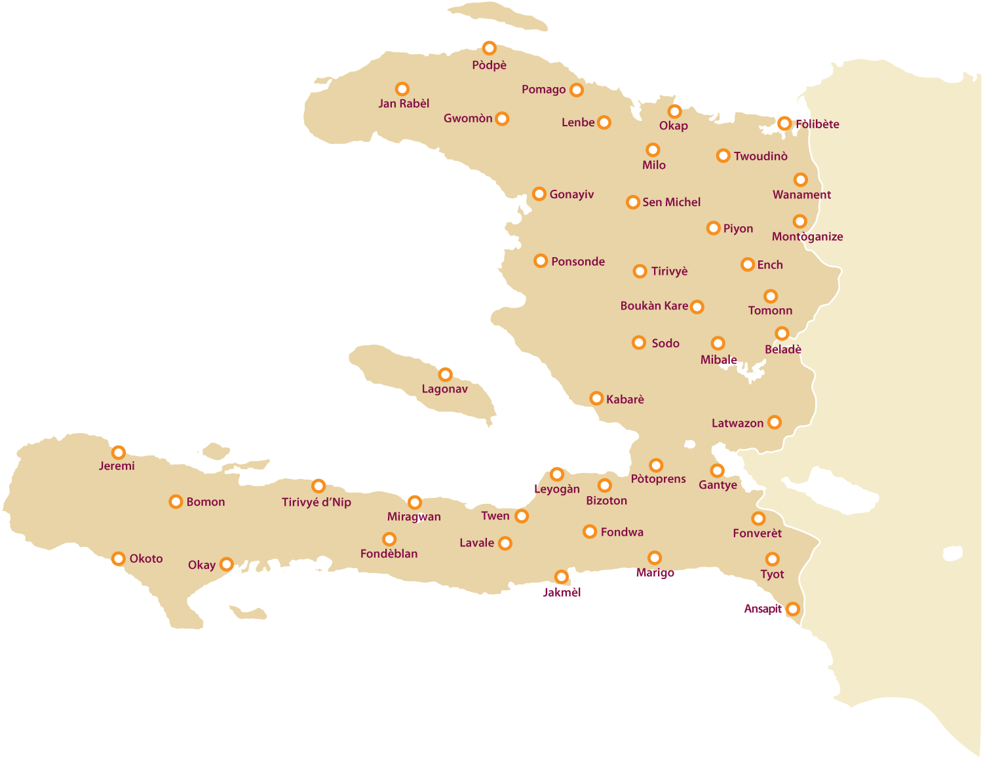

Slide 7
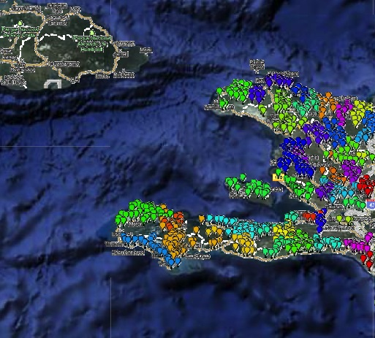
We now have nearly 2,000 Solidarity Centers throughout rural Haiti

Slide 8
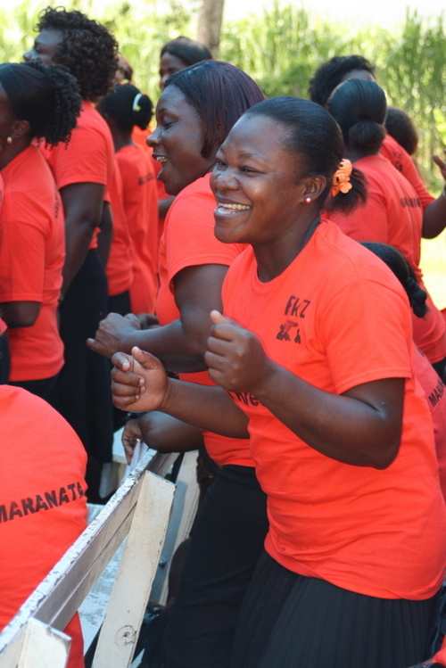
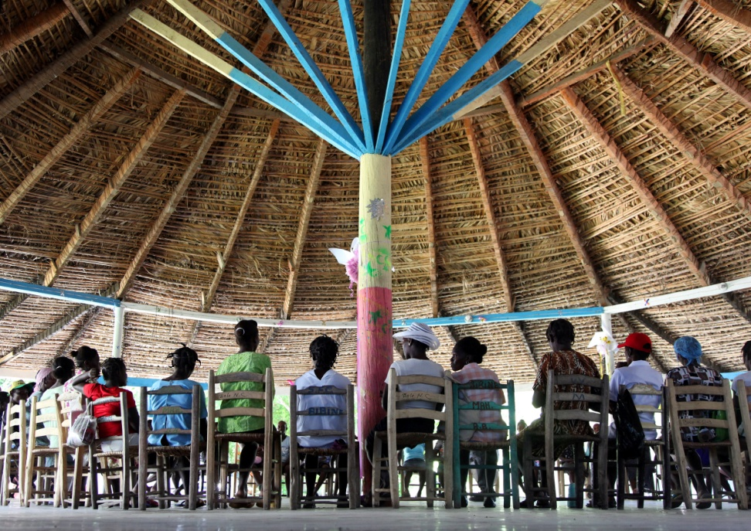

Slide 9
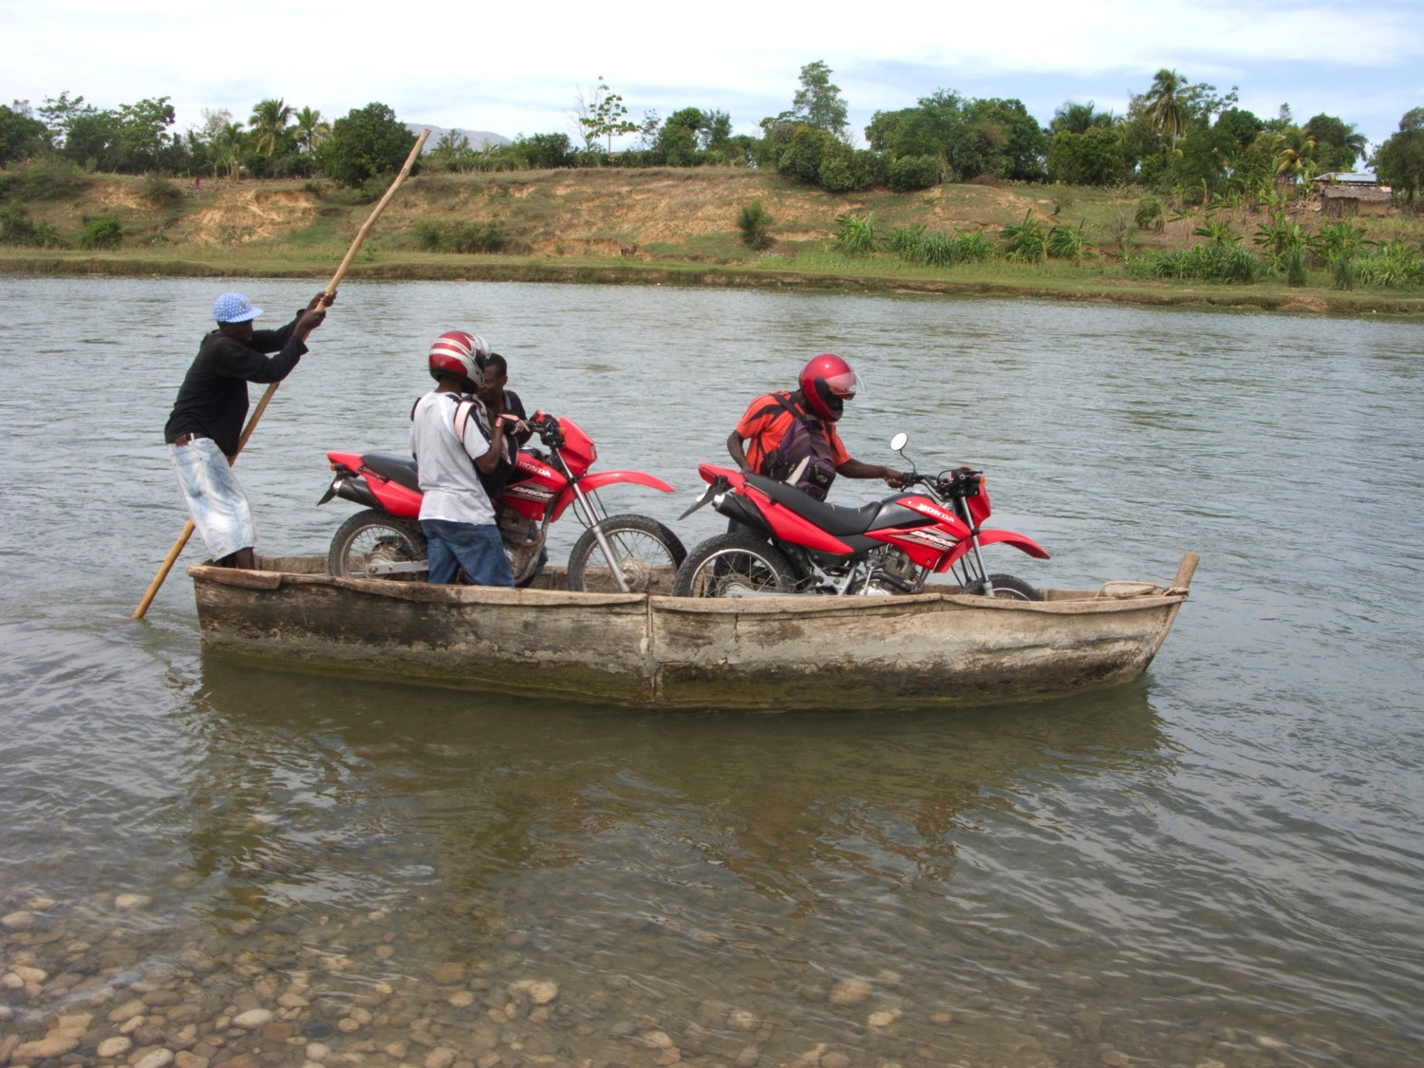

Slide 10
The Fonkoze Approach
Four D’s of microfinance in Haiti
Do it all!
Double Bottom Line
Deep Dive into poverty
Difficult environment

Slide 11
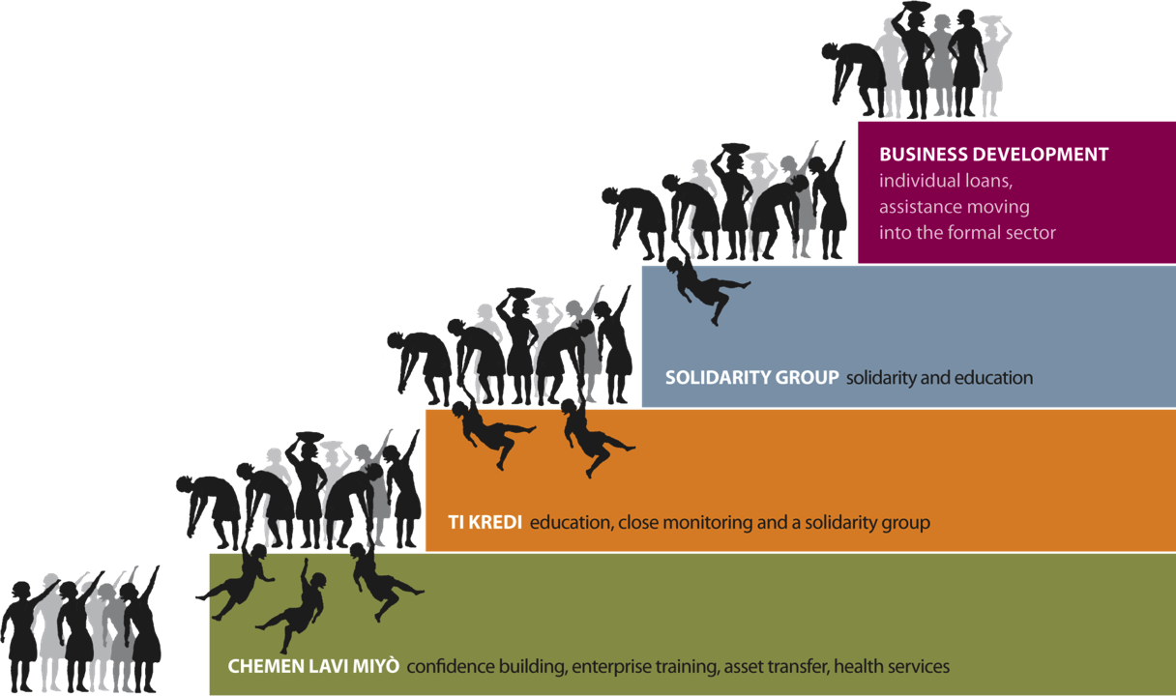

Do it all! Staircase out of Poverty: A Comprehensive Approach to Poverty Alleviation
Microfinance+
… you can’t just give a woman a loan

Slide 12
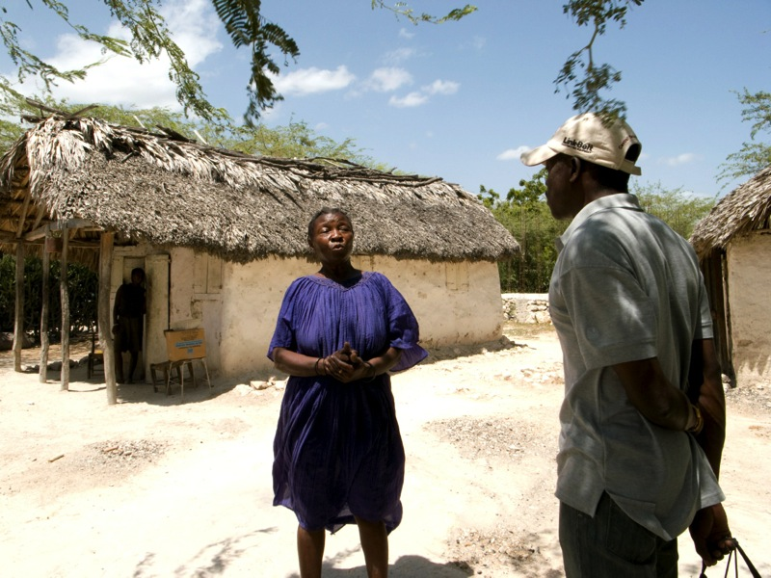
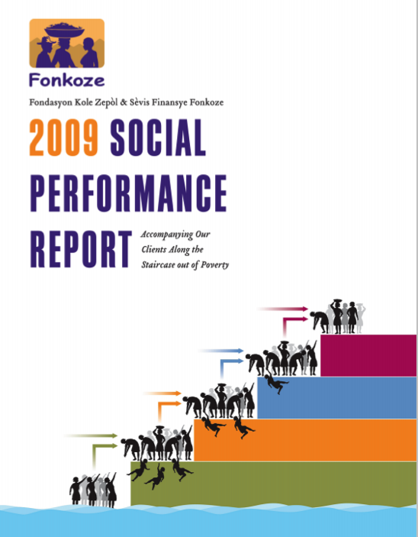
Double Bottom Line
Social and Financial

Slide 13
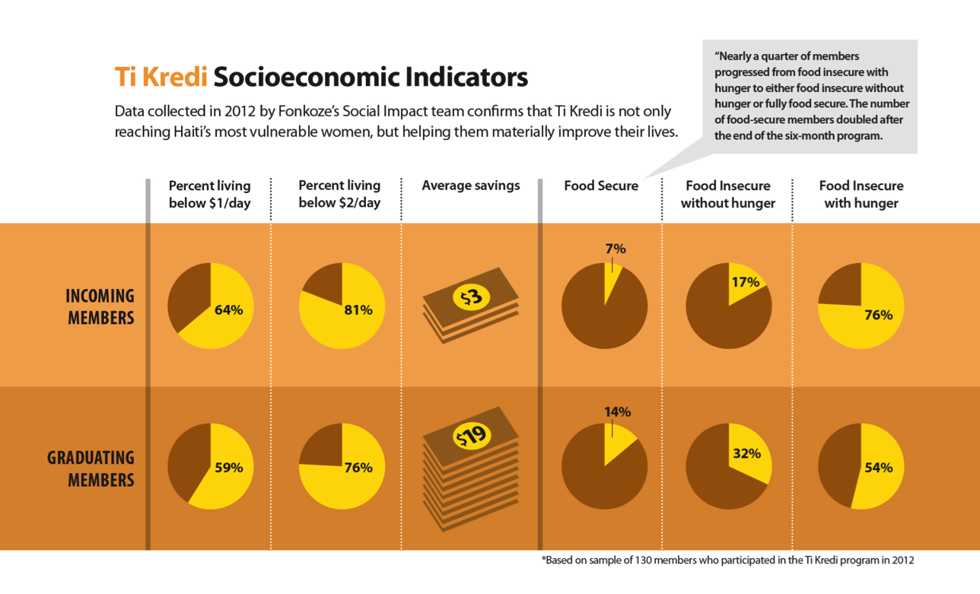
Deep Dive into Poverty

Slide 14

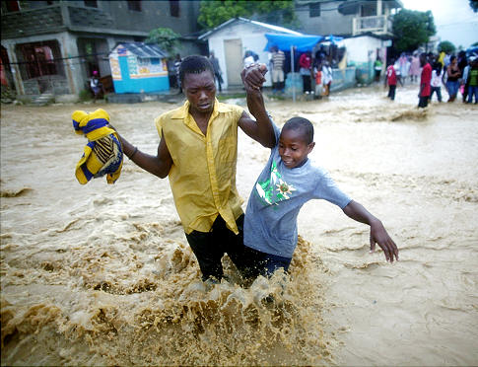
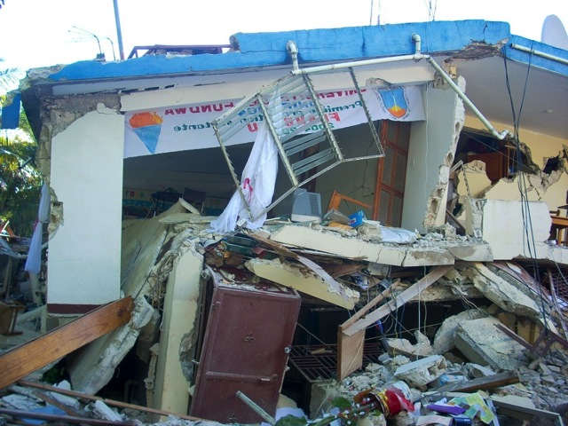
Haiti is one of the most Difficult Environments in the world!

Slide 15
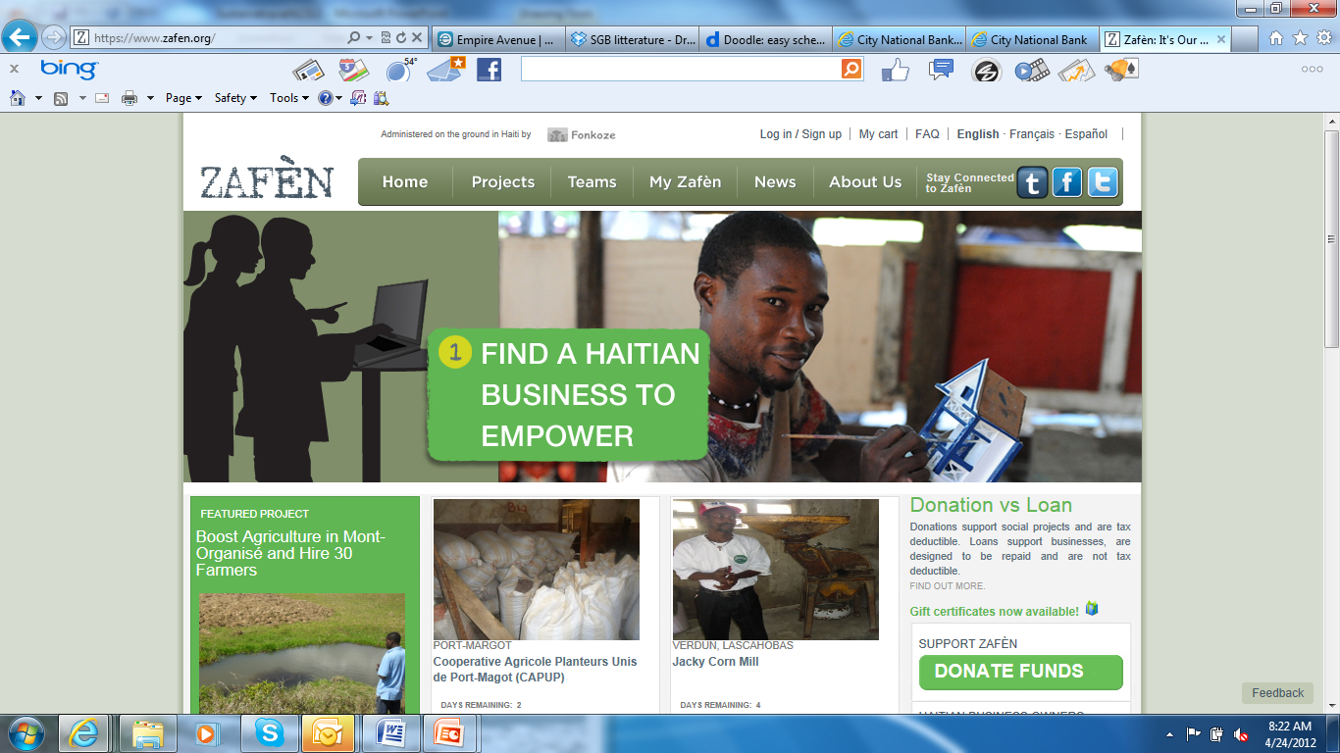
Zafen (www.zafen.org)

Slide 16
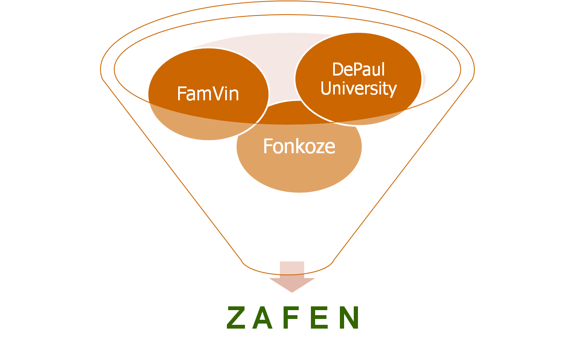
Origins of Zafen (“It’s our business”)
Haitian Diaspora
A joint project of The Worldwide Vincentian Family, Fonkoze, DePaul University and the Haitian Hometown Associations Resource Group Initiated on the occasion of the 350th anniversary of the deaths of St. Louise de Marillac and St. Vincent de Paul

Slide 17
Stats
1700 contributeurs (30 % Diaspora)
775 emplois crees
500+ enterprises/organisations financees
$1.7M + mobilises pour en dons ou prets pour financer leurs projets

Slide 18
The “Missing Middle”
$300,000+
Underserved Market, Untapped Potential
Although constrained, very large businesses can access credit from commercial banks
Micro-entrepeneurs with options, in most part of the country, borrow from MFIs
“Missing middle” are small-and-medium enterprises
Too large for microfinance institutions
Too small for commercial banks
SMEs drive job creation globally and especially in Haiti
Commercial Banking
Sogebank, Unibank, Capital Bank
$10,000 - $300,000
SME Banking
Underserved by microfinance and FDI
Loan Sizes
$1,000 - $10,000
Zafen: Soft loans and BDS
Large Microfinance
Sogesol, MCN (for Capital and not really for rural areas with Collateral no agriculture)
<$1,000
Microfinance Fonkoze, FINCA, ACME
18
*Note: The representations above are the lending levels of focus for each institution, not their exclusive area of lending
Notes:
18

Slide 19
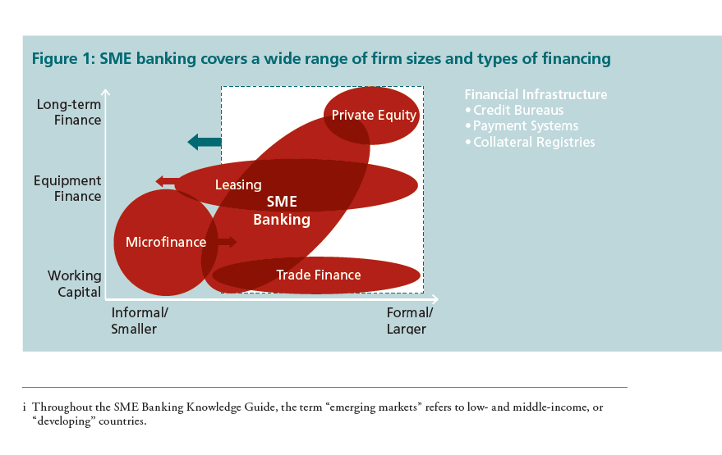
What type of financing?
Source: The SME Banking Knowledge Guide / IFC advisory Services – Access to Finance 2009
Arrows: Zafen loans (14 month no interest loans, 12 equal repayments) should have been tailored for the needs of the clients.

Slide 20
Loan type on Zafen

Slide 21
Zafen Portfolio 2013

Slide 22
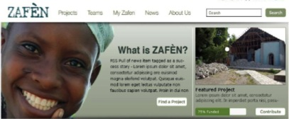
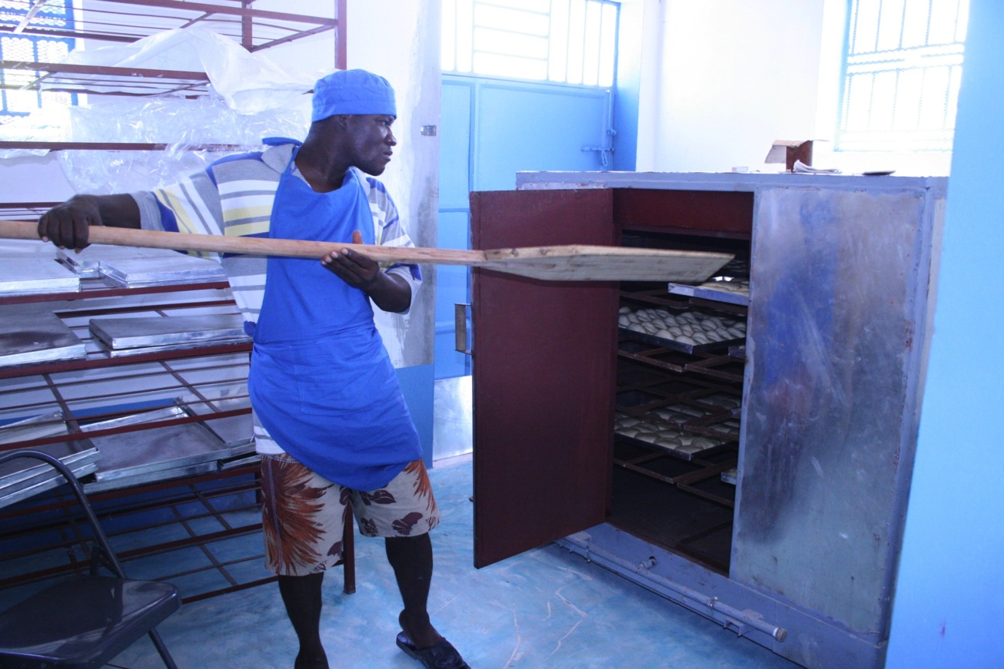

Slide 23
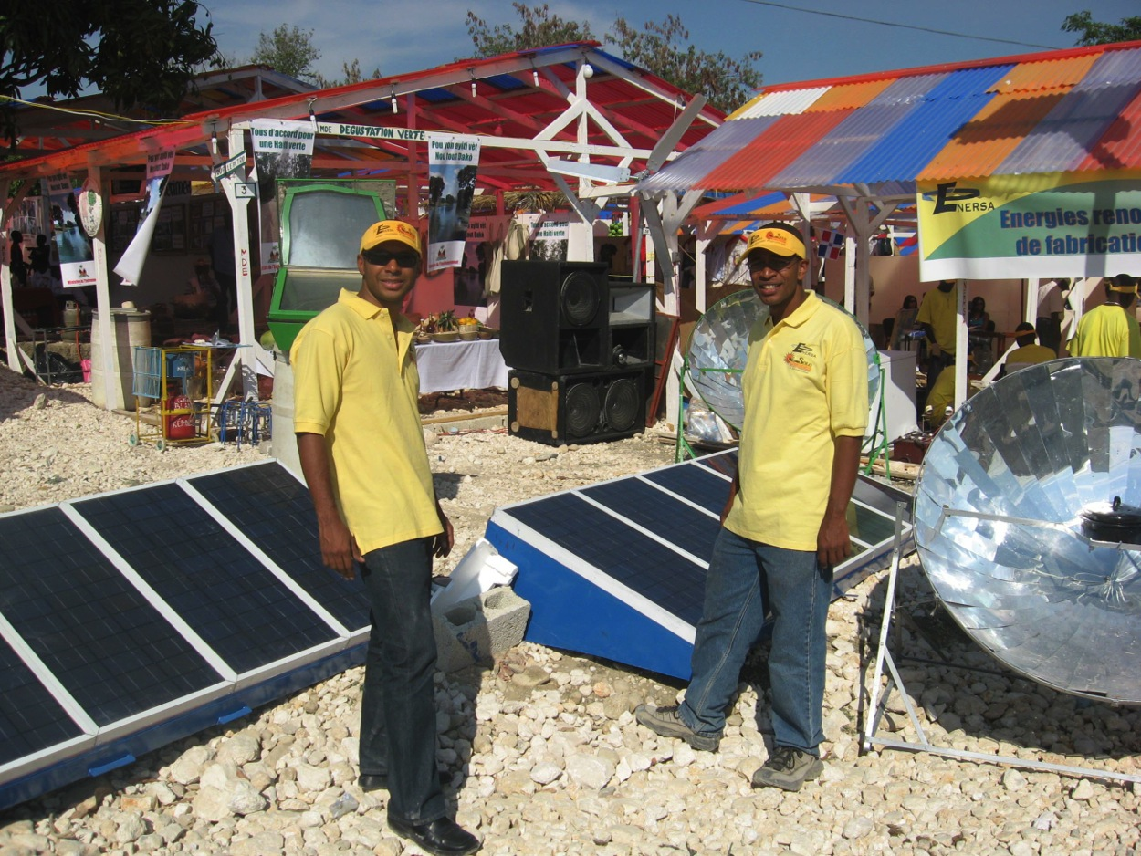

Slide 24
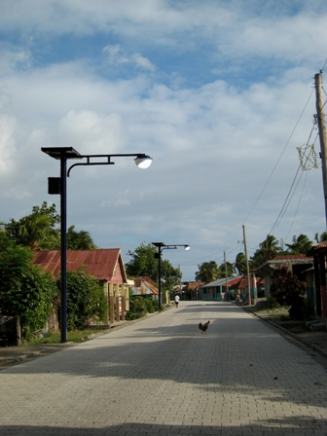

Slide 25
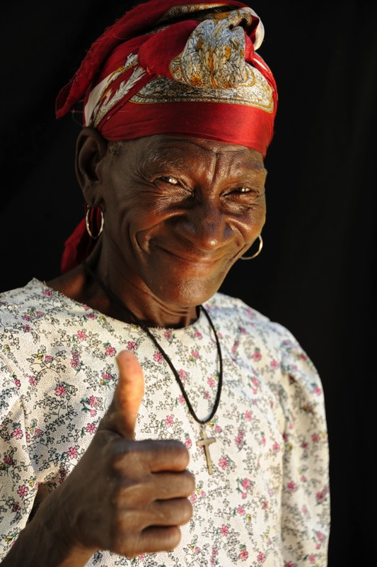
Mèsi Anpil
Thanks for Listening
www.fonkoze.org

